Slide 1
How to become a good QC
Duration: 2h
Rieng Tran
Mar/04/2020

Slide 2
Agenda
Why are we here? (The course objectives)
Why You are NOT a Professional Tester!
Differences b/w Tester's and Developer's Mindsets
Build up Important Characteristics Of A Great Tester
How to make software testing become fun.

Slide 3

Why are you here?
Do you love reading detective books?
Do you love solving logical puzzle?
Do you love helping and interacting with others?
Do you love to take challenges?
AND do you feel really excited when finding out interesting bugs?
AND do you feel extremely happy when your customer informs that the product has delivered successfully to the market without bug?

Slide 4
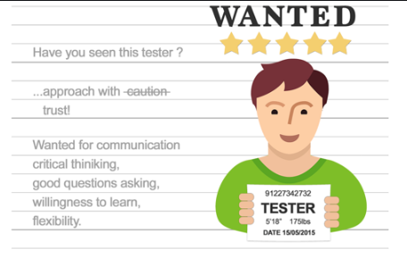
Why You are NOT a Professional Tester!
Poor Communication
Lack of Technical Knowledge
Report a Bug without Analysis
Testing with Assumption
Lack of “Test to Break” Attitude
Stagnant Testing Skills
Lack of Customer point-of-view
Carelessness

Slide 5

Poor Communication
Email communication.
Report communication.
Lack of understanding and asking for clarification.
Lack of energy to communicate.
Unclear requirements and technical knowledge.
Fear of rejection of input or thoughts.
Lack of preparation.

Slide 6
How to improve – be active!
Make sure that Email is turned on and notified to you during working time.
Reply emails right as possible, especially the important ones.
Inform when you are off or go to work late.
Make sure that your important outputs are reached your leader before leaving office.
Don't hesitate to request supporting from your teammate: each of them has a specific strong point that you can learn and improve yourself.
Don't be out of all party (a release party, running for urgent task party, ...)
And don't let yourself become an invisible member right in your team.

Slide 7
How to improve – Make SMART report
Report with SMART - specific, measurable, agreed upon, realistic and time-based.
Your SMART report will give enough information, so that your leader can know where you are working on? Can you reach deadline? Do you need any support?
Which information you should show on your report?
What is your assigned task: brief description
Status: on-time or delay?
% complete: How many completed percentage you really got at that time?
Have you gotten any problem to complete this task on time? If yes, do you have any solution or activity to cover it?
Plan for the next working day(s).
Remember, wait for a bit before leaving office to make sure that your leader has received the report.

Slide 8
Make clear and understand each assignment
Try to understand your responsibility/task by answer following questions:
Do you understand what your task is?
What/where are the input documents?
What are the outputs for this task?
When is the deadline of the task?
Quick estimation: Are you able to complete the task on-time?
What will you do if you can not answer above questions?
If you got stuck on an issue more than 30 min, please report this issue to your leader immediately.
Make a next plan for what you will do during waiting for any confirmation and supporting from your teammate or customer.
Present a main idea about what is your issue? what you need to resolve this issue? which point you had investigated? How about the result?

Slide 9
Understand the whole system
How to understand the whole AUT. During preparation phase, try to study as many inputs as possible
Customer documents. they may be
Basic requirement or SOW (Statement of Work), Order document.
ScreenSpec (GUI spec), USDM (functional and non-functional requirement spec), External requirement spec, API spec, sequence diagram, setting file spec, etc
SCT/CT test spec (test cases), test viewpoint (there are projects that customer will provide us kind of test spec), user stories, test scenarios, etc.
DEMO source/file, execution packages (for porting/optimization projects).
kick-off meeting document.
Etc.

Slide 10
Understand the whole system (cont.)
DEV team documents, they often includes
Basic investigation document
System proposal document
WBS (work breakdown structure) --> This document helps us to know main functions.
Estimation document --> This document helps us to know the size/scope of project --> determine the quality index for SCT/CT phase.
wiki page for sharing project info.
Functional specification (if customer doesn't provide us this kind of document)
QC related documents
Test plan
Test cases

Slide 11
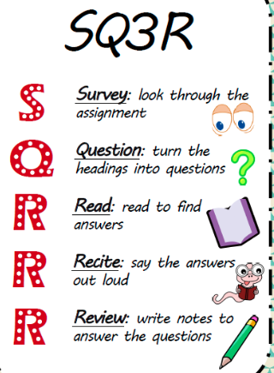
Understand the whole system (cont.)
Must answer two questions
WHAT “testable requirements?”
HOW “we are going to test those requirements?”
Remember that “Most of the bugs in software are due to incomplete or inaccurate functional requirements”
In large-scale projects, we cannot read all specs within limited time, so we need to apply reading techniques
Some Common Reading Techniques
SQ3R – Increasing your retention of written information.
Speed Reading – Radically increasing your reading speed.
Reading Strategies: → Find necessary information quickly and easily.

Slide 12
Lack of Technical Knowledge
List of factors that affect the technical knowledge:
Lack of knowledge about STLC.
Lack of test cases written skills.
Lack of test view points of AUT.
Lack of learning attitude.
Lack of practice.
Lack of energy or enthusiasm.

Slide 13
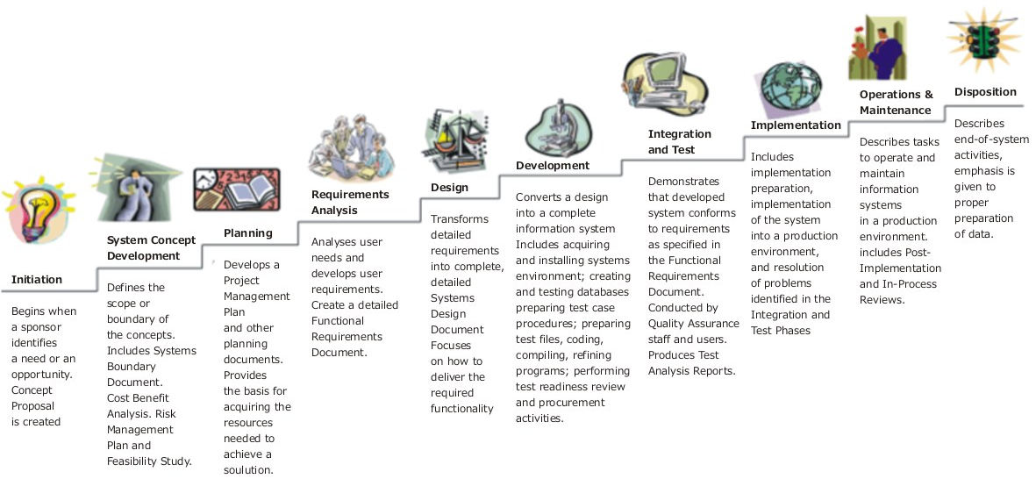
Lack of Technical Knowledge (cont.)
Understand about STLC.

Slide 14
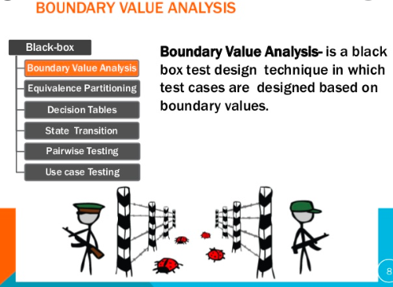
Lack of Technical Knowledge
Know how to apply black-box test design techniques.
Understand deeply the AUT to define correspondent test view-points.
Try to practice the AUT by all mean and as much as possible.
Try to re-use any in-house source e.g. previous bug-lists.
Research the common checklist for the same AUT.

Slide 15

Report a Bug without Analysis
Issues of reporting a defect without analysis
Invalid/Duplicated/Won’t-fix/ Cannot reproduce bugs, etc.
These are caused by
Invalid Test Data, Unstable environment
Incorrect test step, Unclear requirement.
Wrong or out-of-date build releases.
Wrong or out-of-date requirements or spec.

Slide 16
Report a Bug without Analysis – improve steps
Before reporting a bug, check these steps
Make sure that you are used the latest test environment and build release.
Reproduce the issue at least twice to make sure it can be reproduced (for “always” bugs).
Try to shorten the steps to make the bugs clear and exact.
Refresh the bug list on bug tracking tool to make sure the same bug is not reported yet.
Remember: Each bug report is one of your greatest rewards for your hard-working so
Use polite words in your report. You did really good job – had found the defect, but don’t criticize the bug owner this way.
Bug report is very important document and must be written in proper way. It connects tester, developer and manager. Writing a good bug report helps build your trust as well as create a good relationship between tester and developer.

Slide 17
Report a Bug without Analysis (cont.)
Know bug severity
Blocker
Blocking most of test cases of that screens/features; the system cannot run, crash/coredump continuously etc.
Critical
Crashes/coredump but can run another functions (can continue testing); blocked screen;
Major
Normal bugs (Actual behavior is different from expectation) --> effect 1 or 2 test cases.
Minor
Cosmetic problem like misspelled words or misaligned text.
GUI issues
Enhancement
Thing that could be enhanced for easier usage, very little problem.

Slide 18
Report a Bug without Analysis (cont.)
Know bug priority
Urgent
Block most of or full test-case of UI-screen(s)/feature(s).
Blocking issue (crash/deadlock with reproducibility= Always)
The issues belong to features that is near to released deadline.
High
Block about more 15 test cases.
Crash/deadlock with reproducibility= Intermittent)
The issues that re-open more than twice.
Normal
Block about under 15 test cases.
Crash/deadlock with reproducibility= Once)
GUI issues
Low
Minor issues.

Slide 19
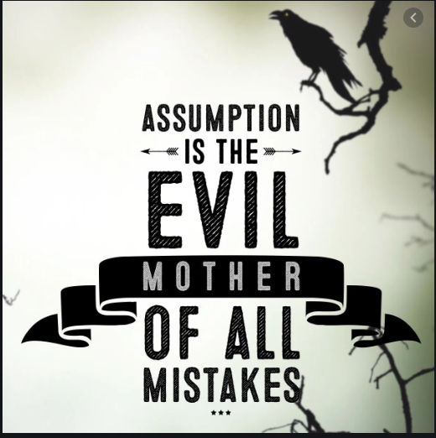
Testing with Assumption
The common assumptions during testing:
Its sign are “I think that..”, “Because…”
Assume about requirements.
Assume behaviors, functionality or requirements without actually referring to any documents.
Assume about test environment/scope.
Assume about the system behavior rather than checking the actual requirements Assume about dev. knowledge
The developer has more knowledge of the application and they have made the code correctly.
Assume about yourself knowledge.

Slide 20
How to stop making assumptions
First, we always remind ourselves that “things will go wrong in any given situation, if you give them a chance”. So DO NOT assume anything.
Try to following steps.
Never test based on assumptions, make clear and understand requirements. If you are not clear on a specific requirement then ask your doubt without any hesitation. Else the defect missed due to such assumptions may cost huge to the project.
“Whatever can go wrong, will go wrong."
– Murphy’s law
Notice
Doubt
Clarify
Recognize
Question

Slide 21
Lack of “Test to Break” Attitude
Factors affect the “Test to Break” attitude:
Think positive, ignore negative thoughts about the AUT and its workflow.
No exploratory testing or ad-hoc testing approach.
Not attentive while testing.
Testing only normal or happy path flow.
Missing check-points or test viewpoints.
Don’t think out-of-box
Don’t try with different point of view.

Slide 22

How to build up “Test to Break” Attitude

Slide 23
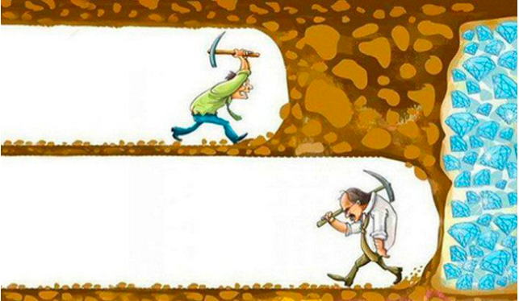
How to build up “Test to Break” Attitude (cont.)
Understand the whole AUT as in-depth as possible.
Be patient: To find out the hidden bugs in the system that might occur for special conditions and causes a strong impact on the system.
Know 80-20 rule in Testing (The Pareto rule)
80% of bugs are found in 20% of the code.
90% of downtime comes from 10% (or less) of defects
Bugs cluster in certain parts of code, especially serious bugs. Most of your most serious problems will come from a small number of bugs.
“80% of the errors and crashes in Windows and Office were caused by 20% of the entire pool of bugs detected.” Microsoft’s CEO: 80-20 Rule Applies to Bugs, Not Just Features Oct 2002

Slide 24
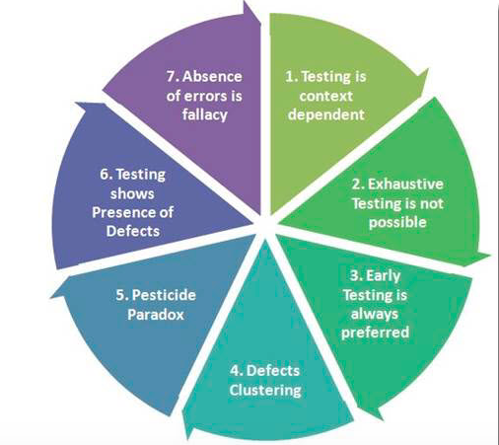
How to build up “Test to Break” Attitude (cont.)
Know 7 principles in software testing:

Slide 25

Stagnant Testing Skills
Points cause Stagnant testing skills:
Lack of pro-activeness to learn the application.
Getting bored at work.
Feeling it as a monotonous job and doing nothing new in the day-to-day testing life.
You may be in a “comfort zone”.
Not yet decided on the carrier objective or goals.

Slide 26
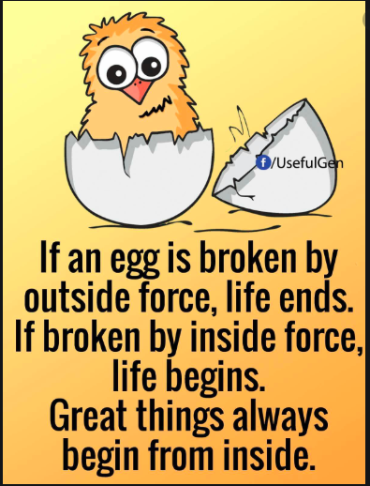
Stagnant Testing Skills (cont.)
Stop it immediately! Let’s change your mindset from inside
Ask yourself first
Do you just completes your task and do no more learning about the tool, technology, language etc.?
Do you go beyond your limit and learn new things, nor look for new information in the software industry?
Remember that “Only you know what is right for you”

Slide 27
Lack of Customer Point-of-view
It is a tester’s responsibility to test if an application is working as per the requirement or not. Also thinking “out of the box” they need to consider from the end-user point of view while testing. A bad tester will not think beyond the requirement and identify the bugs.
A bad tester cannot understand the customer and their needs. A bad tester hesitates to ask any doubt or query, this may be because of lack of confidence or lack of technical knowledge.
Every tester needs to understand clearly and while testing must always think what would be the end user’s point of view while using this application and how easy will be the software to use etc.

Slide 28
Carelessness
We are the final gate before delivering the release to customer, so
Do we often forget to reply or proceed emails?
Do we often forget to send reports before leaving office?
Do you double-check or re-read email contents before sending?
Do you forget to add a snapshot/log when reporting bug?
Defect reported with incorrect information or too little information.
Writing incorrect test case or missing a step in a test case?
Lack of listening skills due to which not all the information get captured.

Slide 29
Tester's and Developer's Mindsets
Tester's mindset | Developer's mindset
Objective of testing: to verify and validate the product, find defects prior to release. | Objective of development: to design and build a product.
Together helps achieve a higher level of product quality.
Curiosity, professional pessimism, a critical eye, attention to detail, and a motivation for good and positive communications and relationships. A tester's mindset tends to grow and mature as the tester gains experience. | Often more interested in designing and building solutions. Able to test their own code. Confirmation bias makes it difficult to find mistakes in their own work

Slide 30
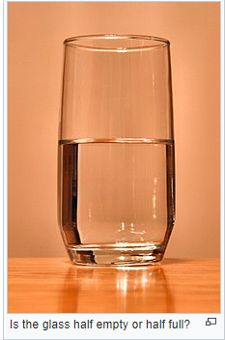
Reasons why developers are not good testers
Naturally, It’s difficult to find defects in something created by yourself.
It may be challenging to think about what could go wrong when you are focused on what the system should do.
Vision: DEV tend to have a solution-oriented mind, while testers need to be problem-oriented, i.e. looking ‘how to break’ things instead of ‘how to build’ them.
QC need to wear the hat of end-user and think about possible scenarios from the user’s standpoint. In these terms, DEV’ awareness of the way the system works can prevent them from seeing alternative scenarios that could cause some unexpected behavior.
Inability to see small details in the big picture.

Slide 31
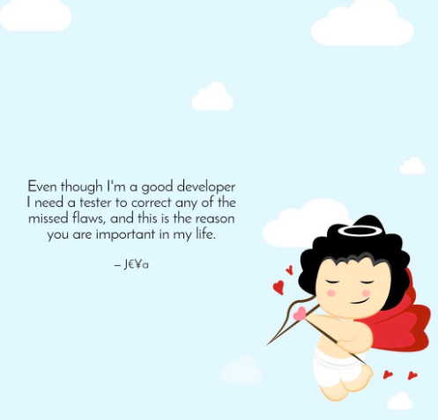

DEV, QC, we make quality together
We make quality together.
The final quality is the continuous effort of the whole team.
The work of a software tester means not only finding bugs, but preventing them. That includes requirements analysis, process optimization, and the implementation of a continuous testing approach. In this sense, a tester’s mindset means caring about quality during all stages of the software development life cycle.

Slide 32
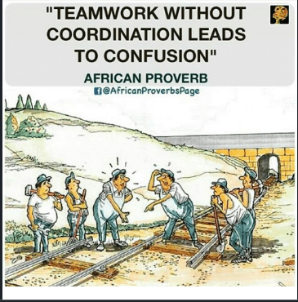
DEV, QC, we make quality together (cont.)
Finally, we must remember …

Slide 33
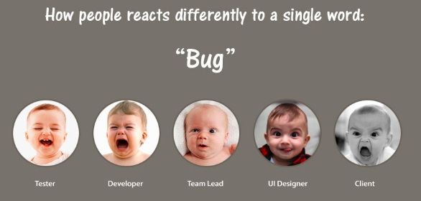
How to make testing fun
Do you really feel excited when discovering critical bugs?

Slide 34

How to make testing fun
Work with strong passion about quality.
Constantly improve skills in manual and automated testing.
Build up communication skills. Good communication with the clients, developers and managers is an important aspect of career progress.
Enjoy the work, software testing is interesting and exciting. All successful test engineers think so. Otherwise you feel bored and tired, and the quality of your testing would be low.
Read books, magazines, blogs on software testing.

Slide 35
Good characters of a great QC
Analytical skills.
Technical skills.
Good verbal and written communication skill.
GREAT attitude - test to break, detail orientation.
Willingness to learn and suggest process improvements.
Passion for testing.
Technical skills
Analytical skills
Passion
Good QC
Attitude
Communication
Productivity

Slide 36
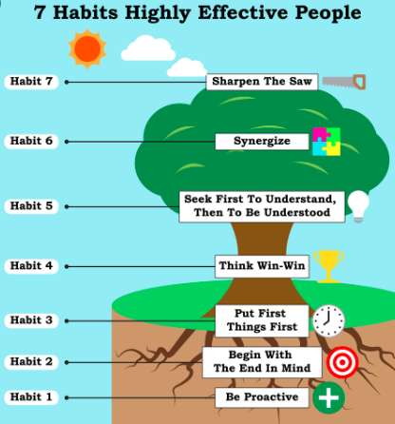
7 habits of highly effective QC
Compare the book by Stephen R. Covey called “The seven habits of highly effective people”
1. Context awareness: always understand the higher objective of what you are doing.
2. Self awareness: realize your personal advantages and limitations.
3. Hands on attitude: a need to stay connected with the concrete tasks taking place.
4. Value of communication: explain simply and correctly
5. Teamwork: collaborate to achieve synergies
6. On-Going Improvement: self & external criticism to keep-on growing
7. Urge to learn: thirst for the expansion of knowledge.

Slide 37
Course detail form
Course Name | How to become a good QC
Course Description | The course aims to share common issues and how to improve to make testing more effective and fun.
Examination | No
Course objectives | Why You are NOT a Professional Tester! Let’s change! Understand Tester's and Developer's Mindsets. Build up Important Characteristics of a good tester. How to make software testing become fun.
Course duration | 2h
Attended audience | QCs, especially fresher/C1 QCs.

